Slide 1



University Institute of Engineering
DEPARTMENT OF COMPUTER SCIENCE & ENGINEERING
Bachelor of Engineering (Computer Science & Engineering)
Subject Name: Software Testing
Subject Code:20CST-375
DISCOVER . LEARN . EMPOWER

Slide 2
Outline
Terminology
Types of errors
Dealing with errors
Quality assurance vs Testing
Component Testing
  Unit testing
  Integration testing
Testing Strategy
Design Patterns & Testing
System testing
  Function testing
  Structure Testing
  Performance testing
  Acceptance testing
  Installation testing
Outline:- Terminology

Slide 3
Some Observations
It is impossible to completely test any nontrivial module or any system
  Theoretical limitations: Halting problem
  Practial limitations: Prohibitive in time and cost
Testing can only show the presence of bugs, not their absence (Dijkstra)
??
total number of execution paths?
loop 200 times
Testing can only show the presence of bugs

Slide 4
Testing Activities
Requirements
Analysis
Document
Subsystem
Code
Unit
Requirements
Analysis
Document
System
Design
Document
T
est
Tested
Subsystem
User
Manual
Subsystem
Code
Unit
T
est
Tested
Subsystem
Integration
Functional
Test
Test
Integrated
Subsystems
Functioning
System
Tested Subsystem
Subsystem
Code
Unit
T
est
All tests by developer

Slide 5
Testing Activities continued
Client’s
Understanding
of Requirements
Global
Requirements
User
Environment
Functioning
System
Validated
System
Accepted
System
Performance
Acceptance
Installation
Test
Test
Test
Usable
System
Tests by client
Tests by developer
User’s understanding
System in
Use
Tests (?) by user

Slide 6
Levels of Testing in V Model
system
requirements
system
integration
Level of abstraction
software
requirements
acceptance
test
preliminary
design
software
integration
detailed
design
component
test
test and integrate
analyze and design
code &
debug
unit
test
Time
N.B.: component test vs. unit test; acceptance test vs. system integration

Slide 7
Test Planning
[Pressman]
A Test Plan:
  covers all types and phases of testing
  guides the entire testing process
  who, why, when, what
  developed as requirements, functional specification, and high-level design are developed
  should be done before implementation starts
A test plan includes:
  test objectives
  schedule and logistics
  test strategies
  test cases
    procedure
    data
    expected result
  procedures for handling problems

Slide 8
Fault Handling Techniques
Fault Handling
Fault Avoidance
Fault Detection
Fault Tolerance
Design
Methodology
Reviews
Atomic
Transactions
Modular
Redundancy
Verification
Configuration
Management
Testing
Debugging
Unit
Testing
Integration
Testing
System
Testing
Correctness
Debugging
Performance
Debugging

Slide 9
Quality Assurance encompasses Testing
Quality Assurance
Usability Testing
Scenario
Testing
Prototype
Testing
Product
Testing
Fault Avoidance
Fault Tolerance
Atomic
Transactions
Modular
Redundancy
Verification
Configuration
Management
Fault Detection
Reviews
Debugging
Walkthrough
Inspection
Testing
Correctness
Debugging
Performance
Debugging
Unit
Testing
Integration
Testing
System
Testing

Slide 10
Types of Testing
Unit Testing:
  Individual subsystem
  Carried out by developers
  Goal: Confirm that subsystems is correctly coded and carries out the intended functionality
Integration Testing:
  Groups of subsystems (collection of classes) and eventually the entire system
  Carried out by developers
  Goal: Test the interface among the subsystem

Slide 11
System Testing
Terminology:
system testing here = validation testing
System Testing:
  The entire system
  Carried out by developers
  Goal: Determine if the system meets the requirements (functional and global)
Acceptance Testing:
  Evaluates the system delivered by developers
  Carried out by the client. May involve executing typical transactions on site on a trial basis
  Goal: Demonstrate that the system meets customer requirements and is ready to use
Implementation (Coding) and testing go hand in hand
2 kinds of Acceptance testing

Slide 12
Unit Testing
Informal:
  Incremental coding
Static Analysis:
  Hand execution: Reading the source code
  Walk-Through (informal presentation to others)
  Code Inspection (formal presentation to others)
  Automated Tools checking for
    syntactic and semantic errors
    departure from coding standards
Dynamic Analysis:
  Black-box testing (Test the input/output behavior)
  White-box testing (Test the internal logic of the subsystem or object)
  Data-structure based testing (Data types determine test cases)
Write a little, test a little
Which is more effective, static or dynamic analysis?

Slide 13
Black-box Testing
Focus: I/O behavior. If for any given input, we can predict the output, then the module passes the test.
  Almost always impossible to generate all possible inputs ("test cases")
Goal: Reduce number of test cases by equivalence partitioning:
  Divide input conditions into equivalence classes
  Choose test cases for each equivalence class. (Example: If an object is supposed to accept a negative number, testing one negative number is enough)
why?
If x = 3 then …
If x > -5 and x < 5 then …
What would be the equivalence classes?

Slide 14
Black-box Testing (Continued)
Selection of equivalence classes (No rules, only guidelines):
  Input is valid across range of values. Select test cases from 3 equivalence classes:
    Below the range
    Within the range
    Above the range
  Input is valid if it is from a discrete set. Select test cases from 2 equivalence classes:
    Valid discrete value
    Invalid discrete value
Another solution to select only a limited amount of test cases:
  Get knowledge about the inner workings of the unit being tested => white-box testing
Are these complete?

Slide 15
White-box Testing
Focus: Thoroughness (Coverage). Every statement in the component is executed at least once.
Four types of white-box testing
  Statement Testing
  Loop Testing
  Path Testing
  Branch Testing

Slide 16
White-box Testing (Continued)
Statement Testing (Algebraic Testing): Test single statements
Loop Testing:
  Cause execution of the loop to be skipped completely. (Exception: Repeat loops)
  Loop to be executed exactly once
  Loop to be executed more than once
Path testing:
  Make sure all paths in the program are executed
Branch Testing (Conditional Testing): Make sure that each possible outcome from a condition is tested at least once
if ( i =
TRUE) printf("YES\n");
else
printf("NO\n");
Test cases: 1) i = TRUE; 2) i = FALSE

Slide 17
Loop Testing
White-Box Testing
[Pressman]
Simple
loop
Nested
Loops
Concatenated
Loops
Unstructured
Loops
Why is loop testing important?

Slide 18
White-box Testing Example
FindMean(float Mean, FILE ScoreFile)
{ SumOfScores = 0.0; NumberOfScores = 0; Mean = 0;
Read(Scor
eFile, Score);
/*Read in and sum the scores*/
while (! EOF(ScoreFile) {
if ( Score > 0.0 ) {
SumOfScores = SumOfScores + Score;
NumberOfScores++;
}
Read(ScoreFile, Score);
}
/* Compute the mean and print the result */
if (NumberOfScores > 0 ) {
Mean = SumOfScores/NumberOfScores;
printf("The mean score is %f \n", Mean);
} else
printf("No scores found in file\n");
}

Slide 19
White-box Testing Example: Determining the Paths
FindMean (FILE ScoreFile)
{ float SumOfScores = 0.0;
  int NumberOfScores = 0;
  float Mean=0.0; float Score;
  Read(ScoreFile, Score);
  while (! EOF(ScoreFile) {
    if (Score > 0.0 ) {
        SumOfScores = SumOfScores + Score;
        NumberOfScores++;
        }
    Read(ScoreFile, Score);
  }
  /* Compute the mean and print the result */
  if (NumberOfScores > 0) {
      Mean = SumOfScores / NumberOfScores;
      printf(“ The mean score is %f\n”, Mean);
  } else
      printf (“No scores found in file\n”);
}
1
2
3
4
5
6
7
8
9

Slide 20
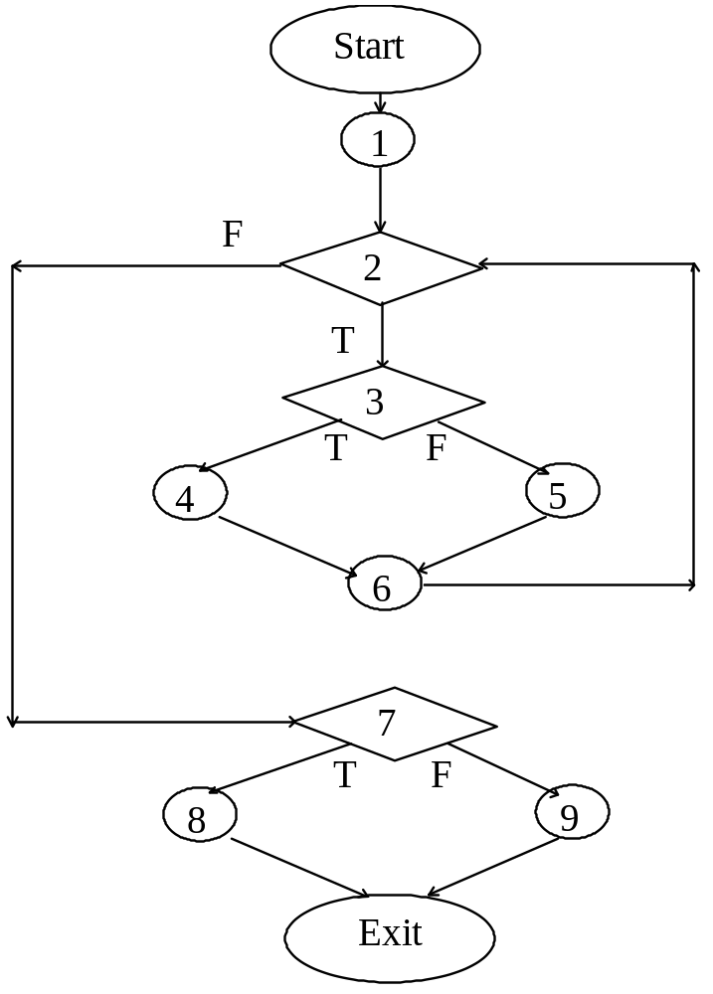
Constructing the Logic Flow Diagram

Slide 21
Finding the Test Cases
Start
1
a (Covered by any data)
2
b
(Data set must contain at least
one value)
(Positive score)
d
3
e
(Negative score)
c
4
5
(Data set must
h
(Reached if either f or
be empty)
f
g
6
e is reached)
7
j
(Total score < 0.0)
i
(Total score > 0.0)
8
9
k
l
Exit

Slide 22
Comparison of White & Black-box Testing 25.1.2002
Self reading
White-box Testing:
  Potentially infinite number of paths have to be tested
  White-box testing often tests what is done, instead of what should be done
  Cannot detect missing use cases
Black-box Testing:
  Potential combinatorical explosion of test cases (valid & invalid data)
  Often not clear whether the selected test cases uncover a particular error
  Does not discover extraneous use cases ("features")
Both types of testing are needed
White-box testing and black box testing are the extreme ends of a testing continuum.
Any choice of test case lies in between and depends on the following:
  Number of possible logical paths
  Nature of input data
  Amount of computation
  Complexity of algorithms and data structures

Slide 23
The 4 Testing Steps
1. Select what has to be measured
  Analysis: Completeness of requirements
  Design: tested for cohesion
  Implementation: Code tests
2. Decide how the testing is done
  Code inspection
  Proofs (Design by Contract)
  Black-box, white box,
  Select integration testing strategy (big bang, bottom up, top down, sandwich)
3. Develop test cases
  A test case is a set of test data or situations that will be used to exercise the unit (code, module, system) being tested or about the attribute being measured
4. Create the test oracle
  An oracle contains of the predicted results for a set of test cases
  The test oracle has to be written down before the actual testing takes place
Next module

Slide 24
Guidance for Test Case Selection
Self reading
Use analysis knowledge about functional requirements (black-box testing):
  Use cases
  Expected input data
  Invalid input data
Use design knowledge about system structure, algorithms, data structures (white-box testing):
  Control structures
    Test branches, loops, ...
  Data structures
    Test records fields, arrays, ...
Use implementation knowledge about algorithms:
  Examples:
  Force division by zero
  Use sequence of test cases for interrupt handler

Slide 25
Unit-testing Heuristics
Self reading
1. Create unit tests as soon as object design is completed:
  Black-box test: Test the use cases & functional model
  White-box test: Test the dynamic model
  Data-structure test: Test the object model
2. Develop the test cases
  Goal: Find the minimal number of test cases to cover as many paths as possible
3. Cross-check the test cases to eliminate duplicates
  Don't waste your time!
4. Desk check your source code
  Reduces testing time
5. Create a test harness
  Test drivers and test stubs are needed for integration testing
6. Describe the test oracle
  Often the result of the first successfully executed test
7. Execute the test cases
  Don’t forget regression testing
  Re-execute test cases every time a change is made.
8. Compare the results of the test with the test oracle
  Automate as much as possible
Big cost -> what should be done?

Slide 26
OOT Strategy
[Pressman]
class testing is the equivalent of unit testing
  operations within the class are tested
  the state behavior of the class is examined
integration applied three different strategies/levels of abstraction
  thread-based testing—integrates the set of classes required to respond to one input or event
  use-based testing—integrates the set of classes required to respond to one use case
  cluster testing—integrates the set of classes required to demonstrate one collaboration
…if there is no nesting of classes
…this is pushing…
Recall: model-driven software development

Slide 27
OOT—Test Case Design
[Pressman]
Berard [BER93] proposes the following approach:
1. Each test case should be uniquely identified and should be explicitly associated with the class to be tested,
2. A list of testing steps should be developed for each test and should contain [BER94]:
  a. a list of specified states for the object that is to be tested
b. a list of messages and operations that will be exercised as a consequence of the test how can this be done?
c. a list of exceptions that may occur as the object is tested
d. a list of external conditions (i.e., changes in the environment external to the software that must exist in order to properly conduct the test)
{people, machine, time of operation, etc.}
This is a kind of data structure testing

Slide 28
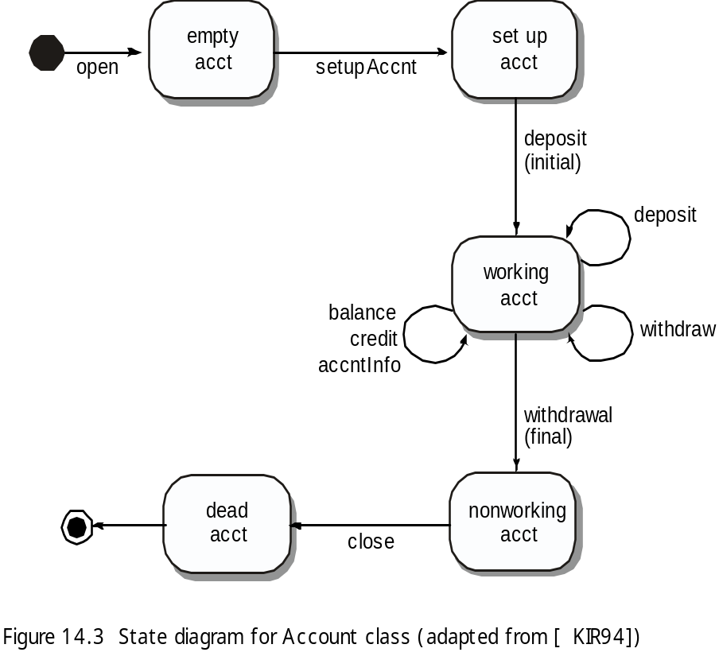
OOT Methods: Behavior Testing
[Pressman]
The tests to be designed should achieve all state coverage [KIR94]. That is, the operation sequences should cause the Account class to make transition through all allowable states
This can act as an oracle

Slide 29


Who Tests the Software?
[Pressman]
developer
independent tester
Understands the system
Must learn about the system,
but, will test "gently"
but, will attempt to break it
and, is driven by "delivery"
and, is driven by quality

Slide 30
NFRs: Reliability
[Chung, RE Lecture Notes]]
Counting Bugs
Sometimes reliability requirements take the form:
"The software shall have no more than X bugs/1K LOC"
But how do we measure bugs at delivery time?
Bebugging Process - based on a Monte Carlo technique for statistical analysis of random events.
1. before testing, a known number of bugs (seeded bugs) are secretly inserted.
2. estimate the number of bugs in the system
3. remove (both known and new) bugs.
# of detected seeded bugs/ # of seeded bugs = # of detected bugs/ # of bugs in the system
# of bugs in the system = # of seeded bugs x # of detected bugs /# of detected seeded bugs
Example: secretely seed 10 bugs
an independent test team detects 120 bugs (6 for the seeded)
# of bugs in the system = 10 x 120/6 = 200
# of bugs in the system after removal = 200 - 120 - 4 = 76
But, deadly bugs vs. insignifant ones; not all bugs are equally detectable; ( Suggestion [Musa87]:
"No more than X bugs/1K LOC may be detected during testing"
"No more than X bugs/1K LOC may be remain after delivery,
as calculated by the Monte Carlo seeding technique"

Slide 31
Summary
Testing is still a black art, but many rules and heuristics are available
Testing consists of component-testing (unit testing, integration testing) and system testing, and …
OOT and architectural testing, still challenging
User-oriented reliability modeling and evaluation not adequate
Testing has its own lifecycle

Slide 32
Additional Slides

Slide 33
Terminology
Reliability: The measure of success with which the observed behavior of a system confirms to some specification of its behavior.
Failure: Any deviation of the observed behavior from the specified behavior.
Error: The system is in a state such that further processing by the system will lead to a failure.
Fault (Bug): The mechanical or algorithmic cause of an error.
There are many different types of errors and different ways how we can deal with them.

Slide 34
Examples of Faults and Errors
Faults in the Interface specification
  Mismatch between what the client needs and what the server offers
  Mismatch between requirements and implementation
Algorithmic Faults
  Missing initialization
  Branching errors (too soon, too late)
  Missing test for nil
Mechanical Faults (very hard to find)
  Documentation does not match actual conditions or operating procedures
Errors
  Stress or overload errors
  Capacity or boundary errors
  Timing errors
  Throughput or performance errors

Slide 35
Dealing with Errors
Verification:
  Assumes hypothetical environment that does not match real environment
  Proof might be buggy (omits important constraints; simply wrong)
Modular redundancy:
  Expensive
Declaring a bug to be a “feature”
  Bad practice
Patching
  Slows down performance
Testing (this lecture)
  Testing is never good enough

Slide 36
Another View on How to Deal with Errors
Error prevention (before the system is released):
  Use good programming methodology to reduce complexity
  Use version control to prevent inconsistent system
  Apply verification to prevent algorithmic bugs
Error detection (while system is running):
  Testing: Create failures in a planned way
  Debugging: Start with an unplanned failures
  Monitoring: Deliver information about state. Find performance bugs
Error recovery (recover from failure once the system is released):
  Data base systems (atomic transactions)
  Modular redundancy
  Recovery blocks

Slide 37
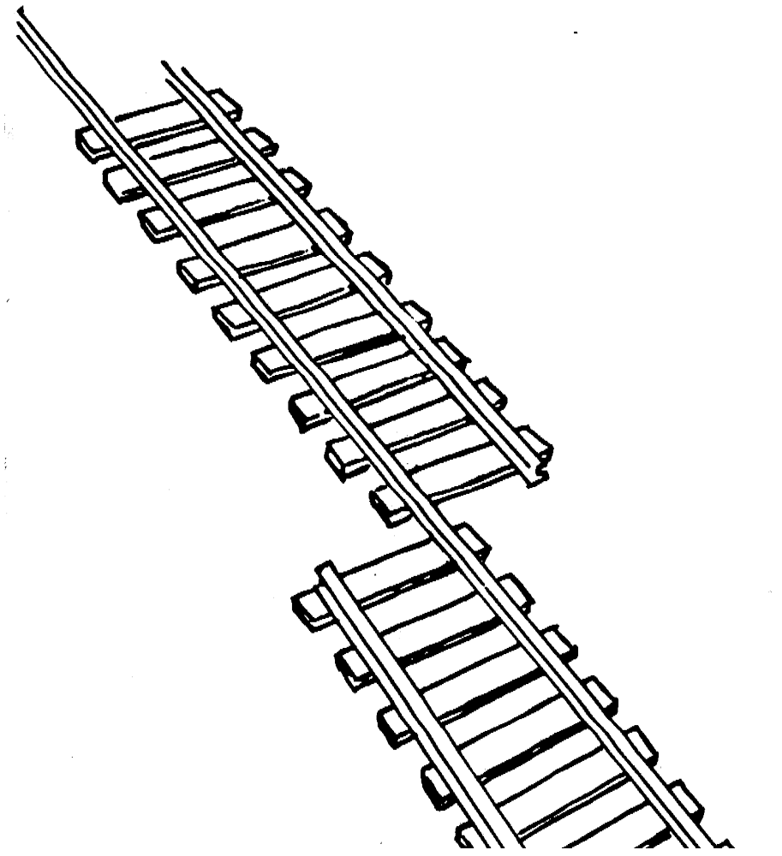
What is this?
A failure?
An error?
A fault?
Need to specify
the desired behavior first!

Slide 38
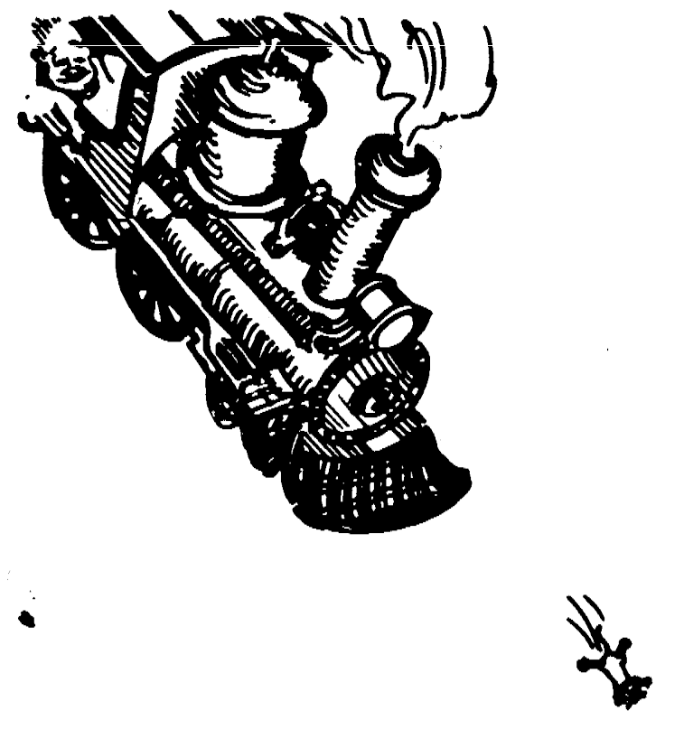
Erroneous State (“Error”)

Slide 39
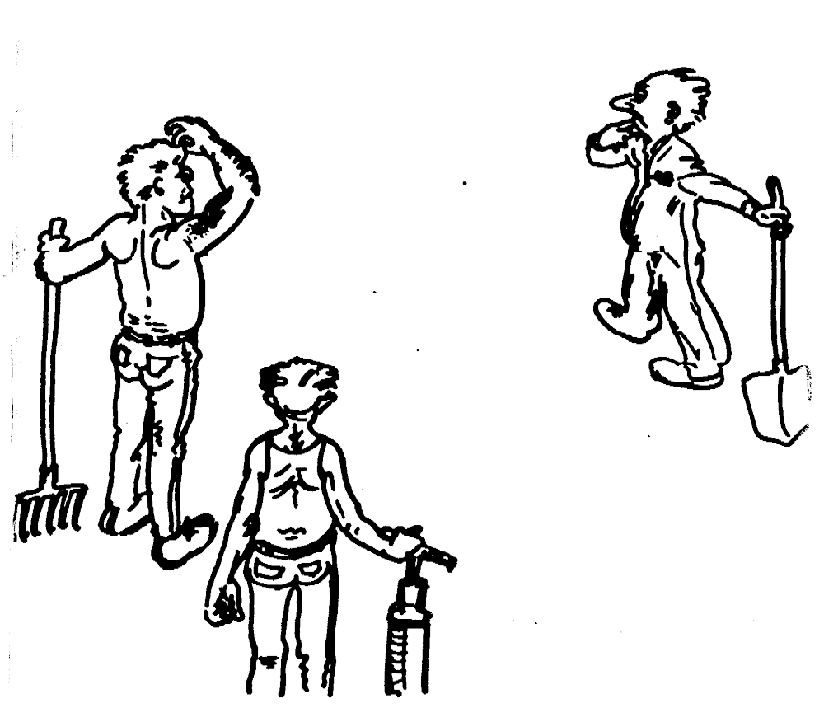
Algorithmic Fault

Slide 40
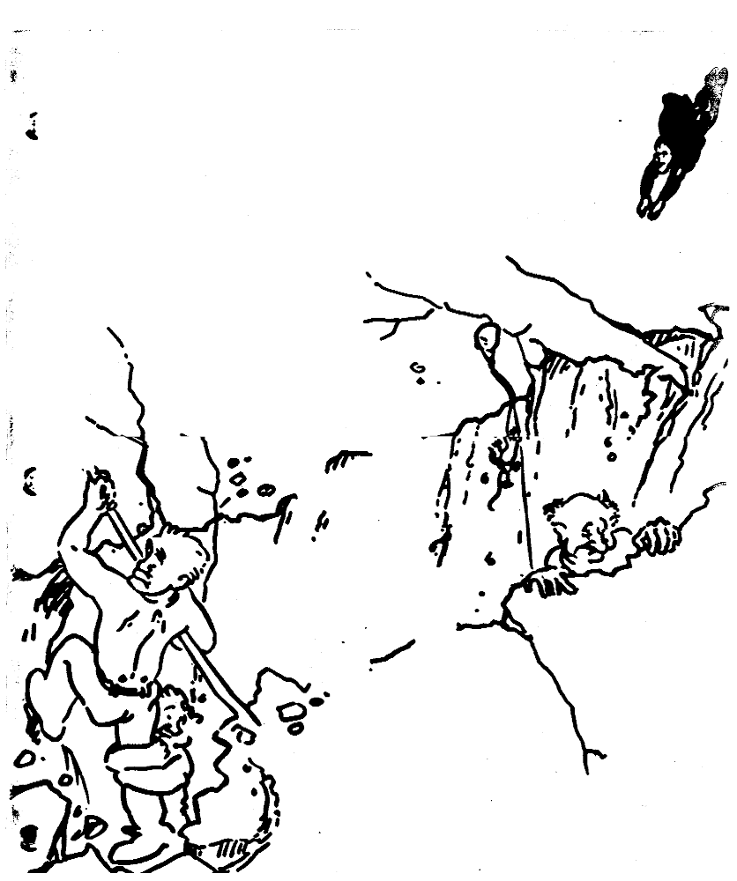
Mechanical Fault

Slide 41
How do we deal with Errors and Faults?

Slide 42
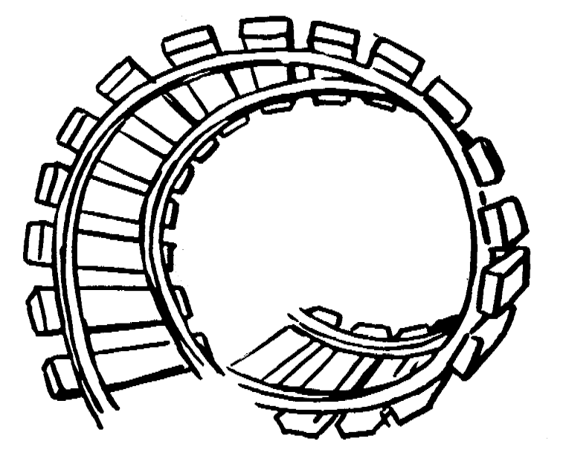
Verification?

Slide 43
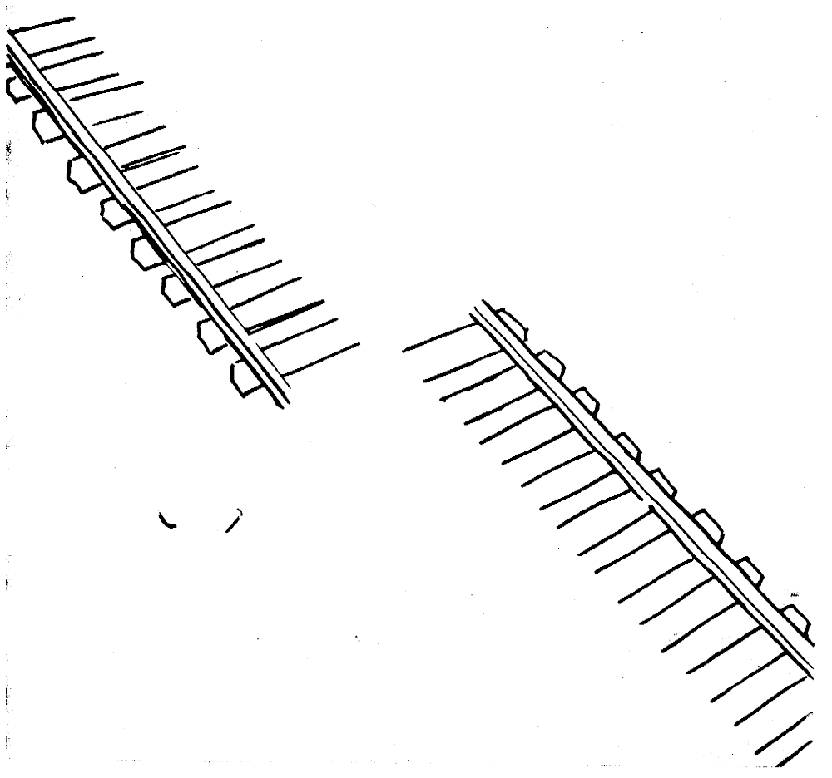
Modular Redundancy?

Slide 44
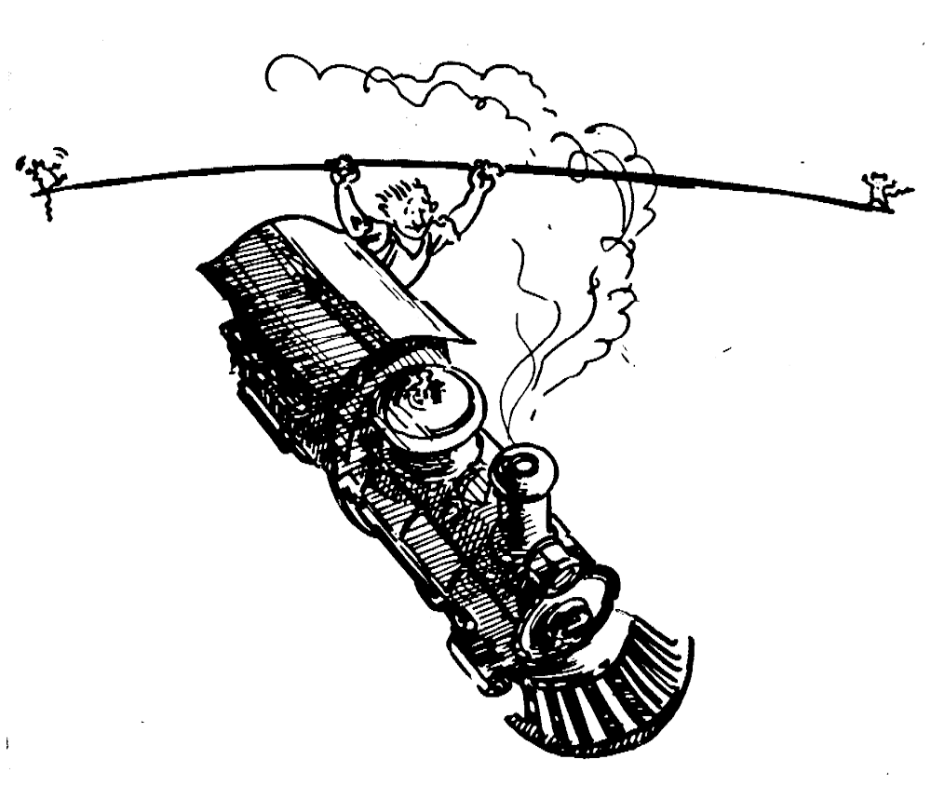
Declaring the Bug as a Feature?

Slide 45
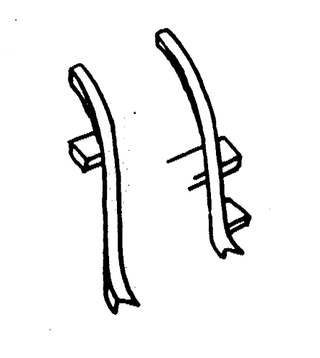
Patching?

Slide 46
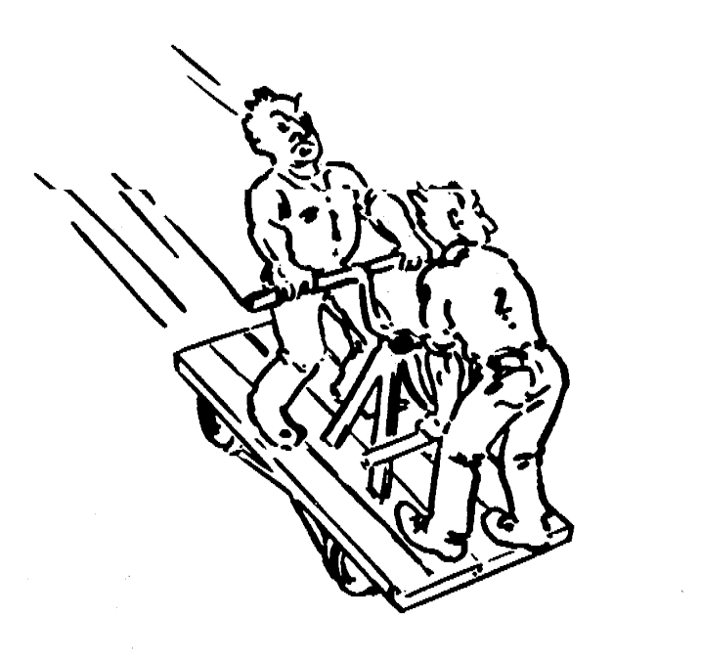
Testing?

Slide 47
Testing takes creativity
Testing often viewed as dirty work.
To develop an effective test, one must have:
    Detailed understanding of the system
    Knowledge of the testing techniques
    Skill to apply these techniques in an effective and efficient manner
Testing is done best by independent testers
  We often develop a certain mental attitude that the program should in a certain way when in fact it does not.
Programmer often stick to the data set that makes the program work
  "Don’t mess up my code!"
A program often does not work when tried by somebody else.
  Don't let this be the end-user.

Slide 48
Test Cases
Test case 1 : ? (To execute loop exactly once)
Test case 2 : ? (To skip loop body)
Test case 3: ?,? (to execute loop more than once)
These 3 test cases cover all control flow paths

